Slide 1





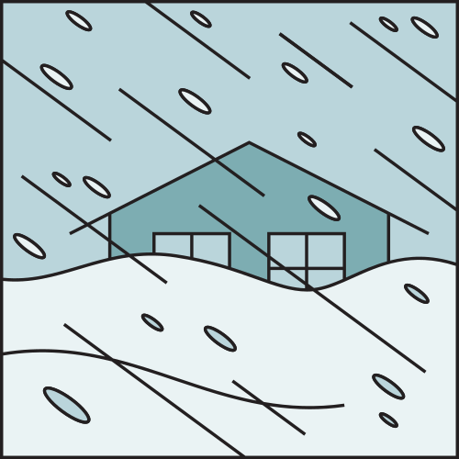



STORMGUARD DEVELOPERS
A DISASTER PREPAREDNESS PORTAL

Slide 2
sYSTEM ANALYSIS AND DESIGN LAB
COURSE INSTRUCTOR: ALIF RUSLAN
COURSE CODE: CSE 306

Slide 3
TEAM -> TRIO INNOVATORS
TEAM MEMBERS:
MD YASIN HOSSAIN AKASH - 22101153
NUSRAT AHMMED MAISHA - 22101160
C. M. HASIBUL HASAN - 22101174

Slide 4
Table of contents
Purpose of Project
Project Proposal
Target Audiences
Requirement Analysis
Agile Methodology
Use Case Diagram
Class Diagram
Activity Diagram
Sequence Diagram
Gantt Chart
User Interface
Future Updates
Conclusion

Slide 5
Purpose of project
Offer a platform for citizens to connect with emergency contacts and services.
Facilitate community participation through donations and volunteer efforts.
Provide timely weather alerts and disaster updates to reduce risks.
Educate the public on proper safety measures before, during, and after disasters.

Slide 6
PROJECT PROPOSAL
PROBLEM STATEMENTS
PROPOSED SOLUTIONS
FEASIBILITIES
Resource Scarcity
Weather Delays
Contact Outdatedness
Lack of Donation Transparency
Volunteer Mismanagement
Language Barriers
Resource Allocation
Real-Time Updates
Contact Database
Transparent Tracking of Donation
Volunteer Portal
Multilingual Support
Technical Feasibility
Infrastructure
User Accessibility
Data Integration
Economical feasibilities
Cost Efficiency
Sustainable funding

Slide 7

TARGET AUDIENCES
Local Communities
Emergency Responders
Government Agencies
Volunteers
Researchers and Academics
International Aid Organizations

Slide 8
REQUIREMENT ANALYSIS
User Registration and Login
Emergency Alert Notification
Location-Based Disaster Information
Volunteer Sign-Up & Management
Disaster Preparedness Guides
Emergency Contact Directory
Donation Tracking
Data Backup for enhanced reliability.

Slide 9
Agile methodology
Requirement Gathering
Design The Requirements
Coding
Collaborate with stakeholders to understand and prioritize needs, focusing on delivering value.
Translate requirements into actionable tasks and create visual representations of the solution.
Develop the software in sprints, delivering increments, continuously integrating, and committing changes regularly.

Slide 10
Agile methodology
Quality
Assurance
Deployment
Feedback
Conduct unit and integration tests in each iteration to ensure quality and functionality.
Automate releases with CI/CD, complete testing, security checks, and documentation before deployment.
Gather feedback via surveys, analytics, and communication to improve the product.

Slide 11
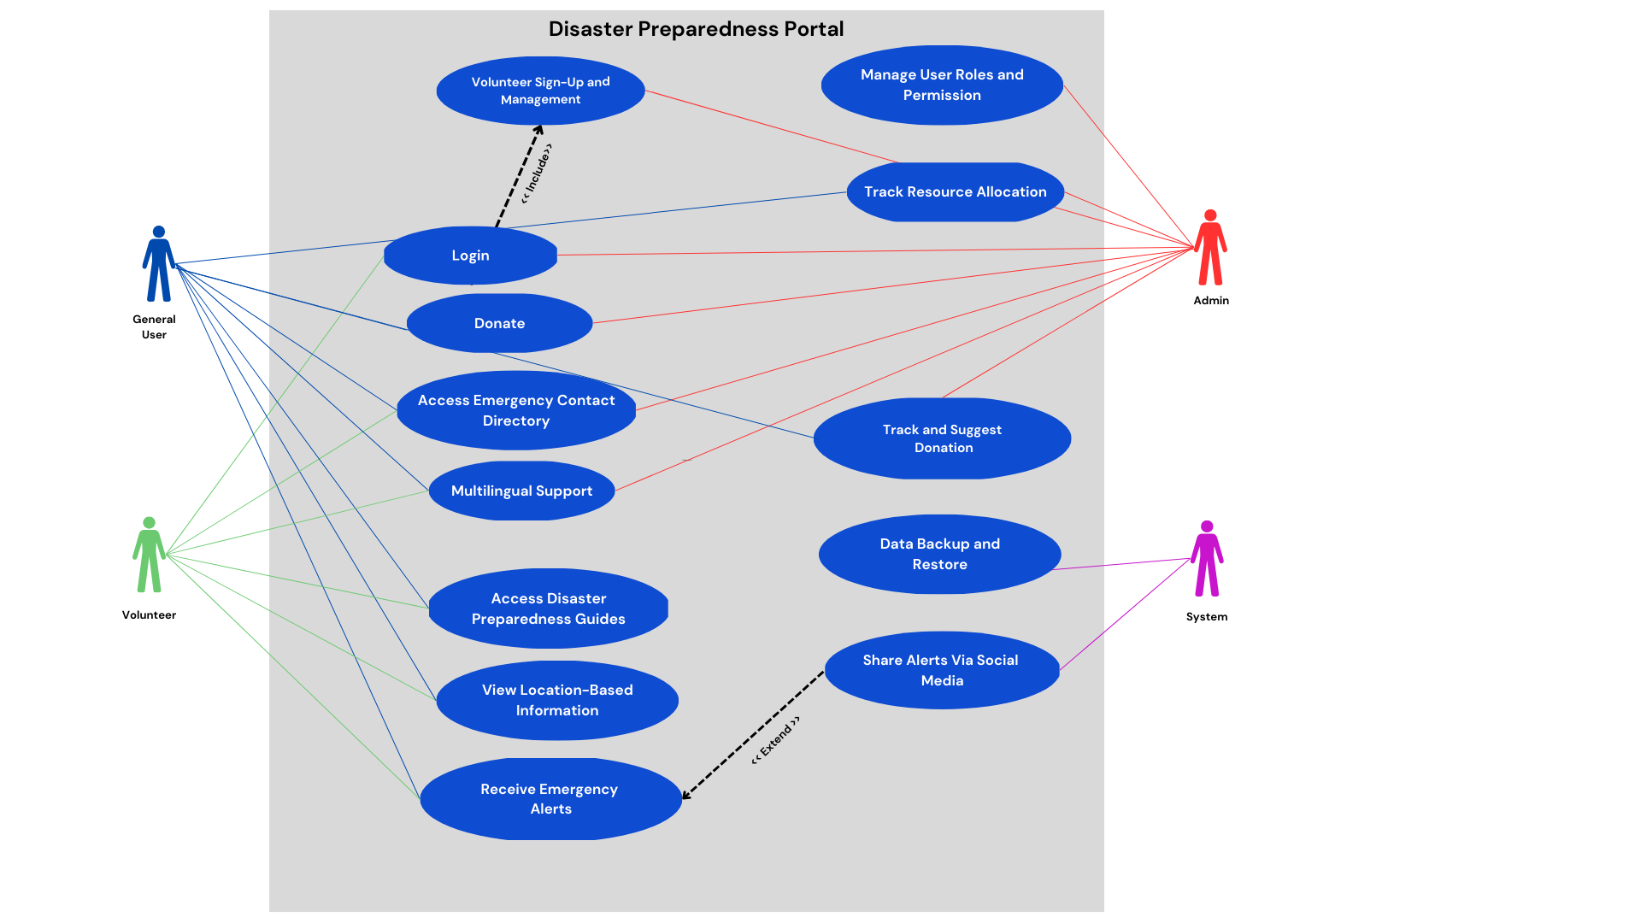
Use case diagram

Slide 12
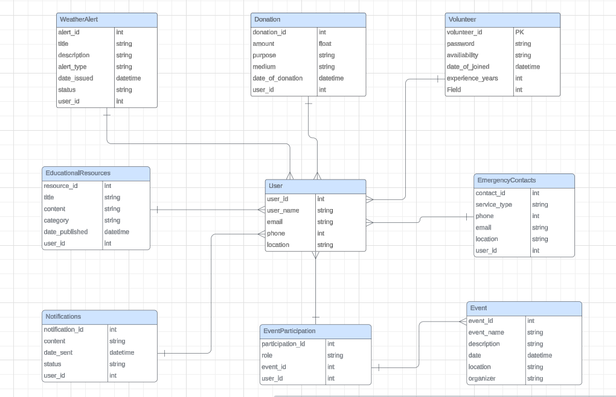
Class Diagram

Slide 13
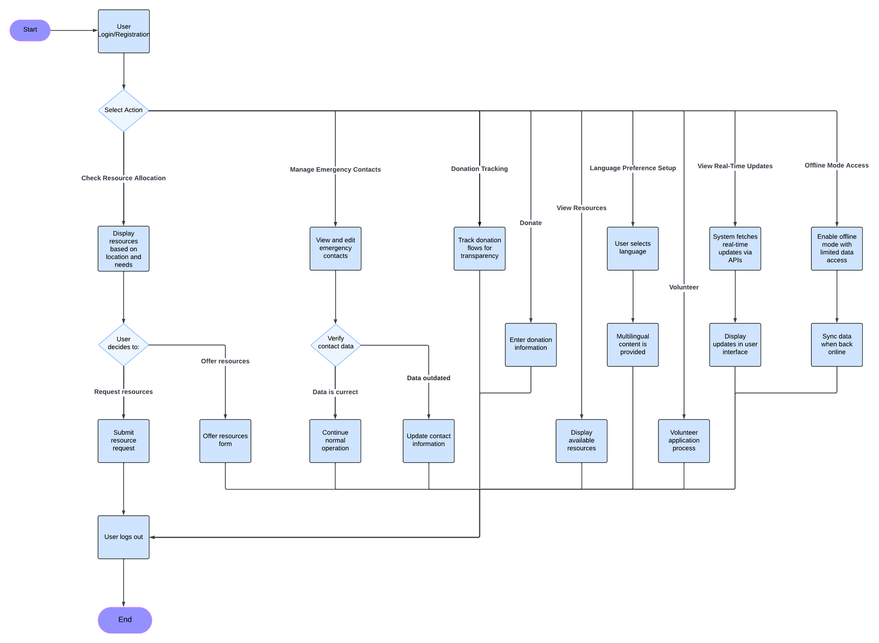
ACTIVITY Diagram

Slide 14
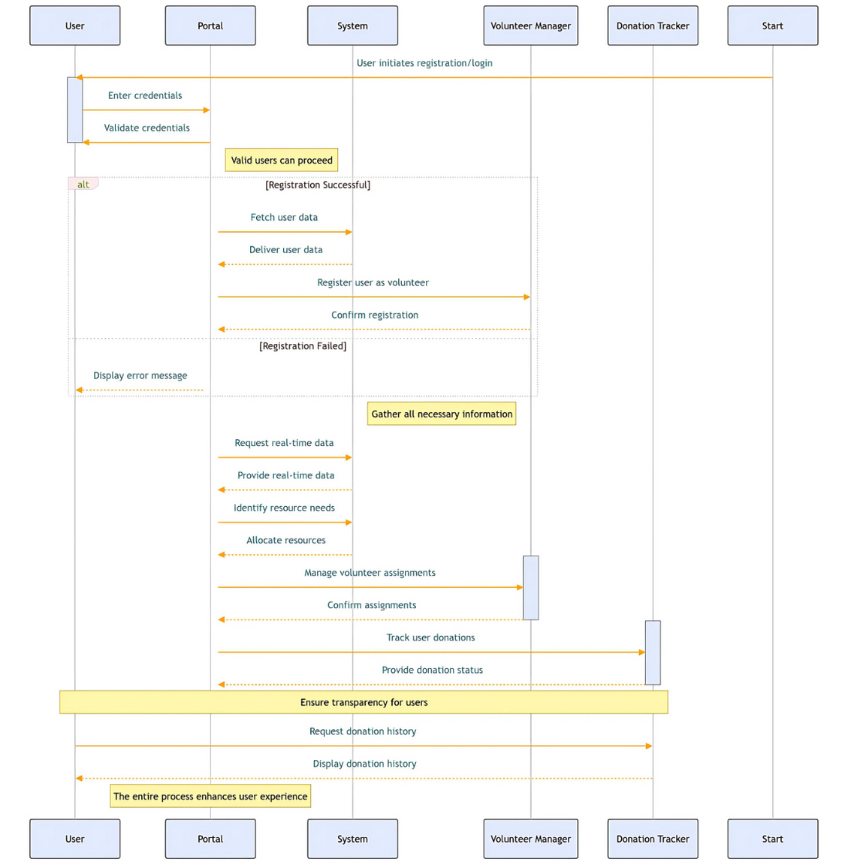
sequence Diagram

Slide 15
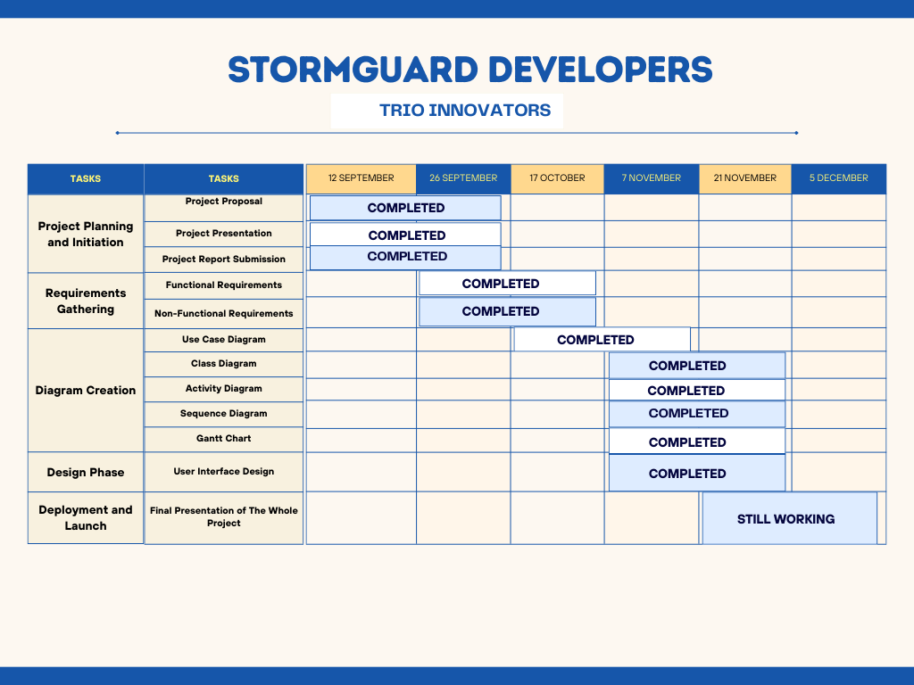
Gantt chart

Slide 16
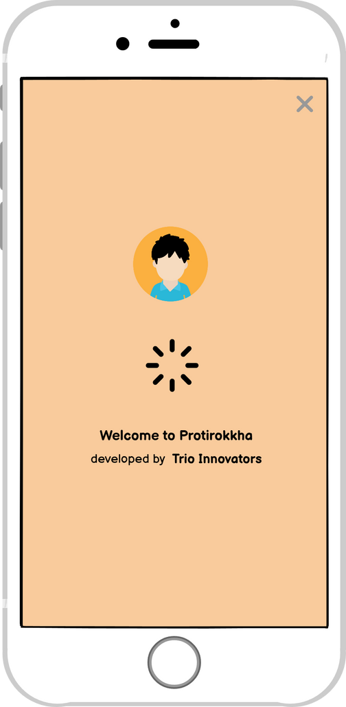
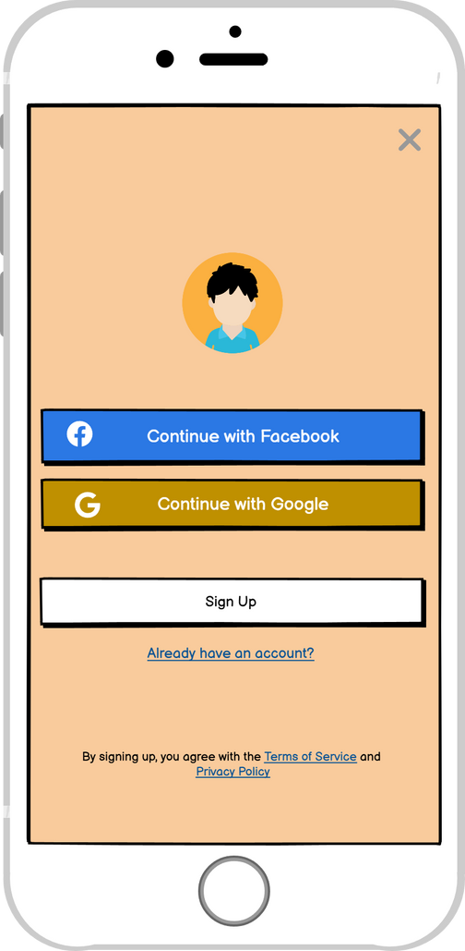
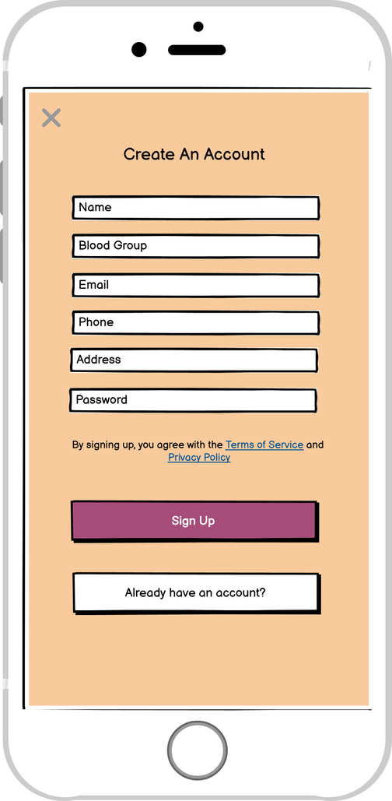
user Interface
user Interface

Slide 17
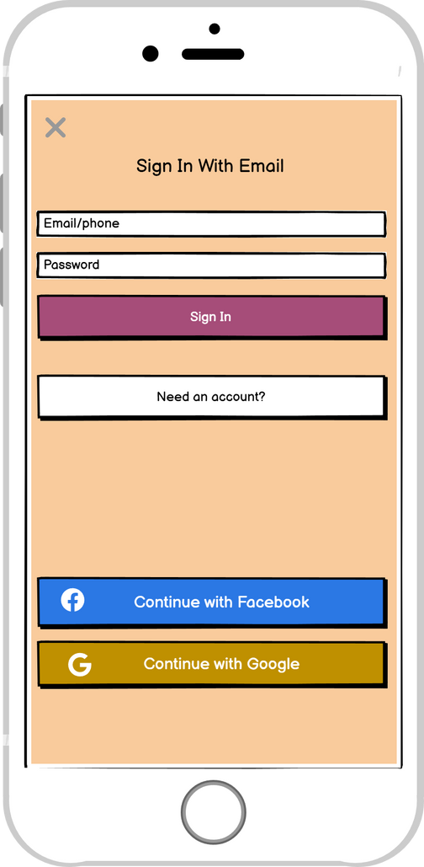
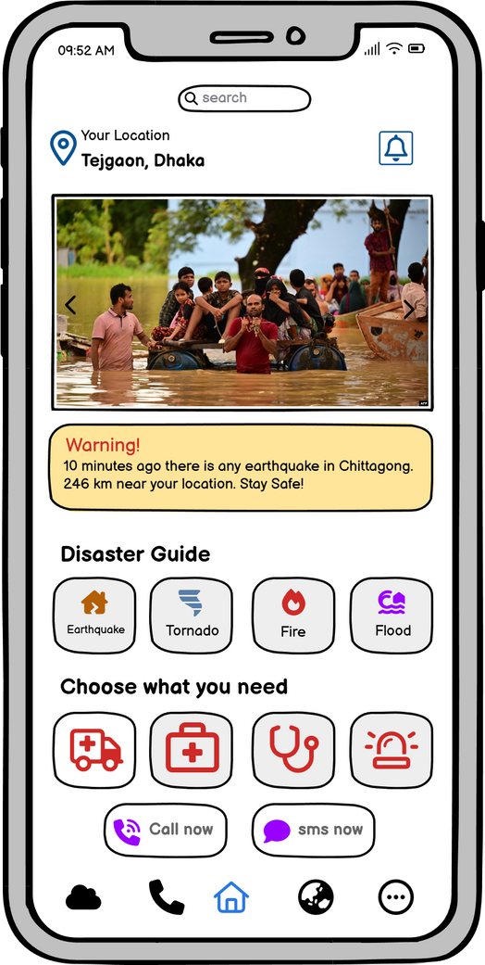
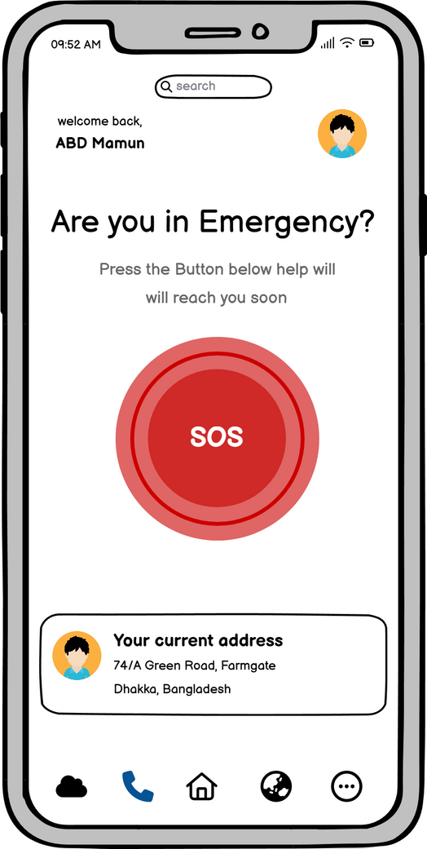
user Interface
user Interface

Slide 18
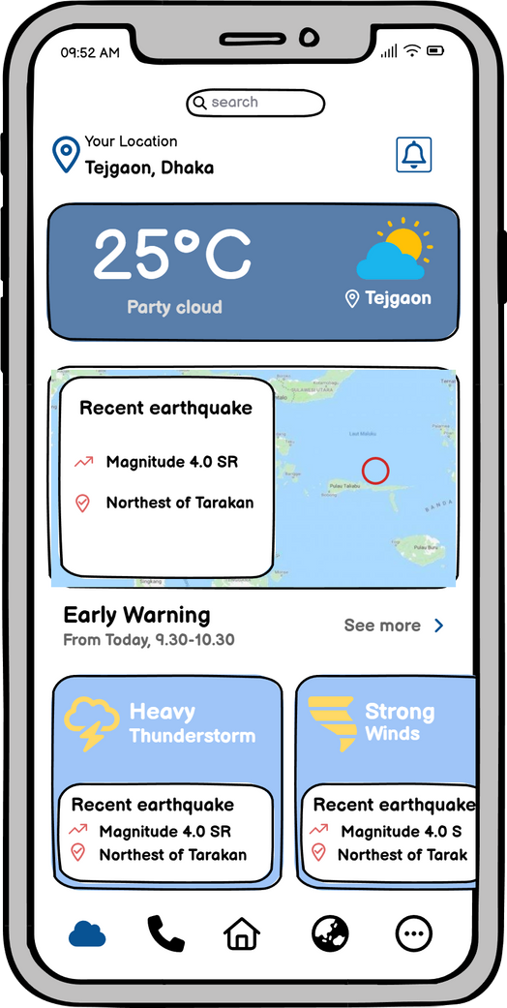
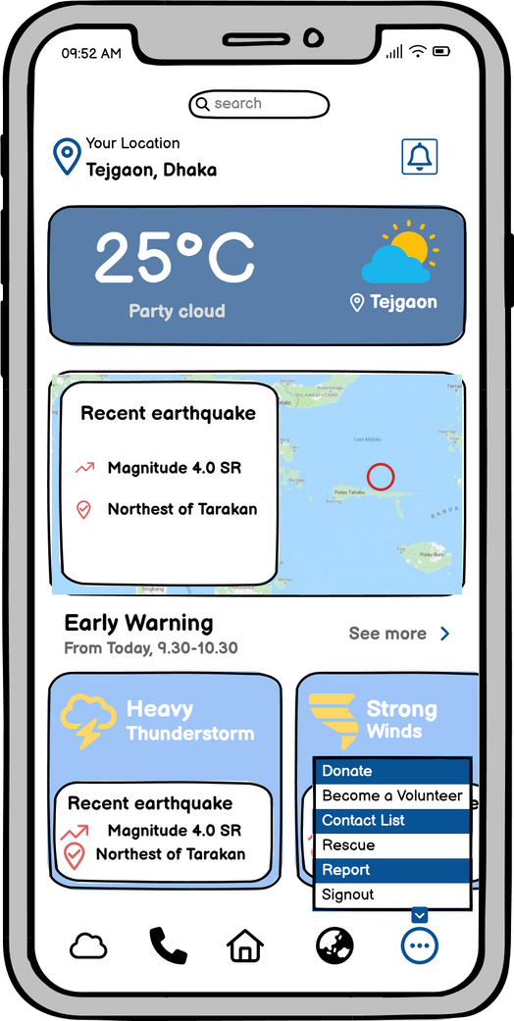
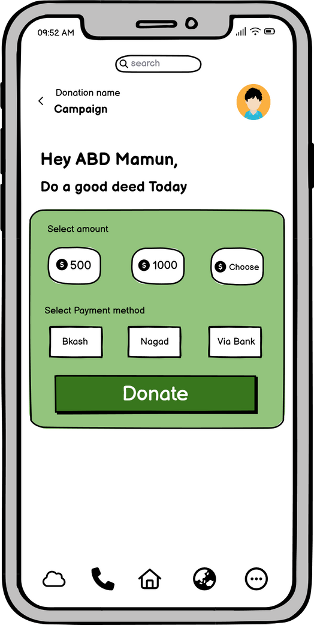
user Interface
user Interface

Slide 19
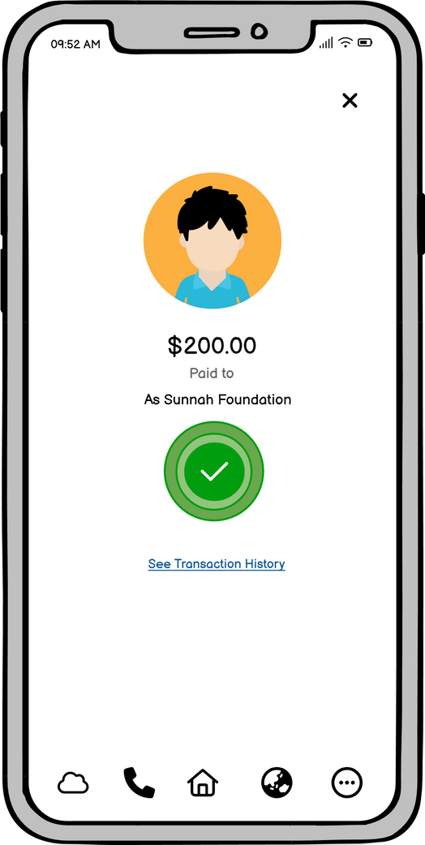
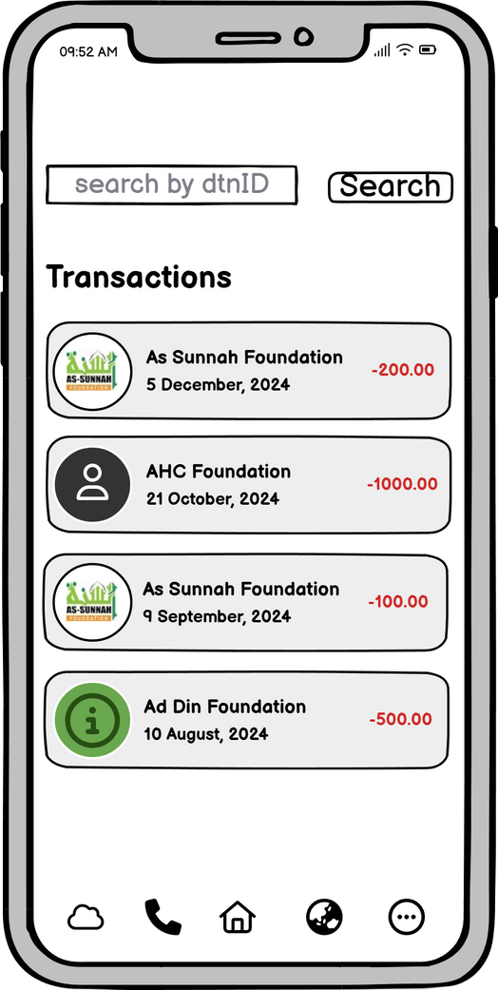
user Interface
user Interface

Slide 20

Future updates
AI-Powered Predictive Analytics
Multi-Lingual Support
Offline Access
Social Media Integration
Accessibility Features

Slide 21
Conclusion
Our Disaster Preparedness Portal, StormGuard, is designed to make disaster management easier and more effective. By providing real-time updates, clear communication, and tools for better resource management, we aim to help communities and responders stay prepared and safe. Together, we can reduce the impact of disasters and build a safer future for everyone.

Slide 22

Thank
You!!!
Feel free to ask any question...

